Slide 1



TRAVEL AGENCY MANAGEMENT SYSTEM
Capstone project​
Presenting By:​
​Shaik Siddiq
Kruthika Hiremath​
Saranya Bhimavarapu​
Varsha S​

Slide 2
CONTENTS
Team description
Introduction​
Proposed project description​
Objective​
System features​
Architectural diagram​
Output screenshots​
Conclusion​

Slide 3
TEAM MEMBERS
Shaik Siddiq - 1033308
Varsha S - 1033340
Kruthika Hiremath – 1033344
Saranya Bhimavarapu - 1033320

Slide 4
INTRODUCTION
Online Tour Agency Management is a very user-friendly project. In this project user can easily understand and book all packages and also register for hotel. ​
In this project there are various types of forms, like all types of packages, book for package and in which users can insert his personal needs & facilities then upload his form by which user can register in the web site.
​
This site provides different packages, destination, and hotel booking services in state of India. In this website, user can search for various types of destination.​
Travel Agency Management is a web-based application made in Asp.net. So with the help of this user can apply for packages of tour and room reservation.​
Admin can also add travel packages and all details of hotel.​

Slide 5
PROPOSED PROJECT DESCRIPTION
In our project Travel Agency Management , we used Visual Studio 2022 and Visual Studio Code.​
Front end design
Front end refers to the visual layer of website and applications. The UI, layout, images and other visual elements.​
We have designed a pages like login and register page, index page, about us and contact us.​
Backend design​
Firstly we created a WebAPI in Visual Studio 2022 with four endpoints like customer, hotel, package and booking.​
As a next step created get, put, post, get by id and delete methods for all the endpoints using angular in Visual Studio 2022.​

Slide 6
OBJECTIVE
This system provides Online Registration, Tour Package Information, Flight ticket booking, Train ticket booking, Bus ticket booking and all other destinations.​
Our objective is to make strong relationship with customers so that they can enjoy the holiday of their dreams.​
It saves lots of time, now a days there is a fast process world any one can work quickly so, this project helps that people who are searching for reservation in organization, so they can easily fill up the form and search rooms and different tourist place.​

Slide 7
SYSTEM FEATURES
1. User Authentication
Secure login and registration for customers and administrators.
2. Customer Management:
Profile creation and management for customers.
View personal information.
Booking history and prefer destination.
3. Booking System:
Develop a user-friendly interface for customers to search and book travel services.
Include options for flights, hotels, transportation, and activities.

Slide 8
4. Hotel Booking:
Admin can add and edit hotels based on location, price, and amenities.​
Real-time availability and booking confirmation.​
5. Package Management:
Creation and customization of travel packages.​
Include options for flights, accommodations, activities, and transportation.​
Dynamic pricing based on selected components.​

Slide 9
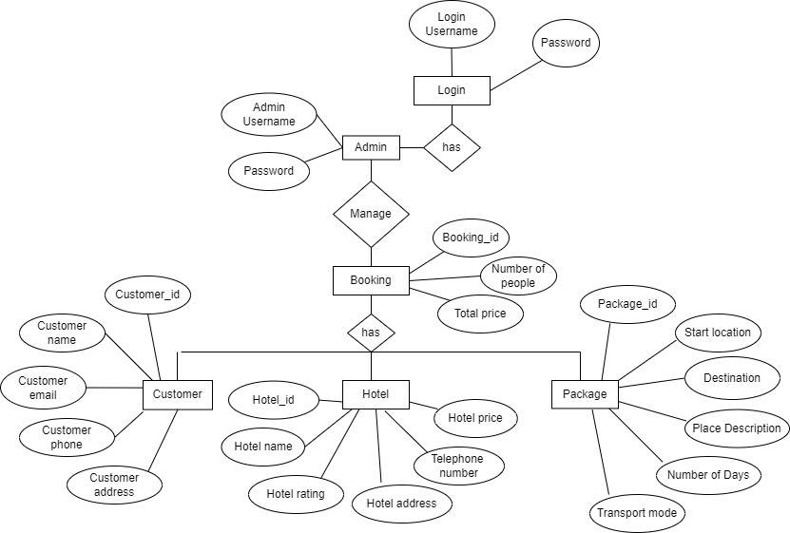
E-R DIAGRAM

Slide 10
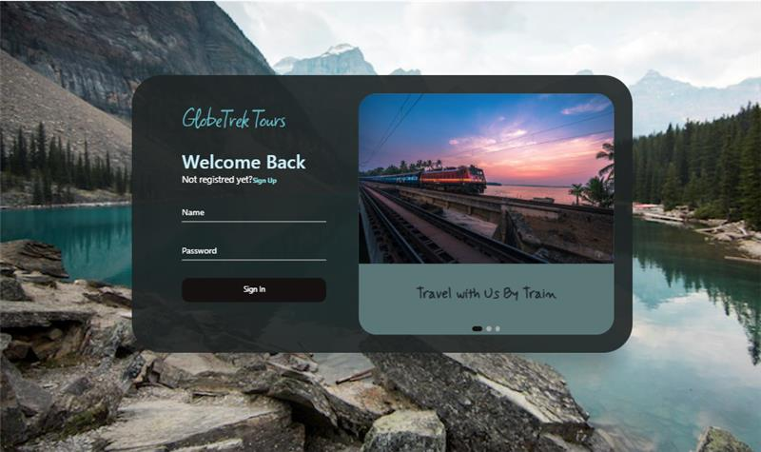
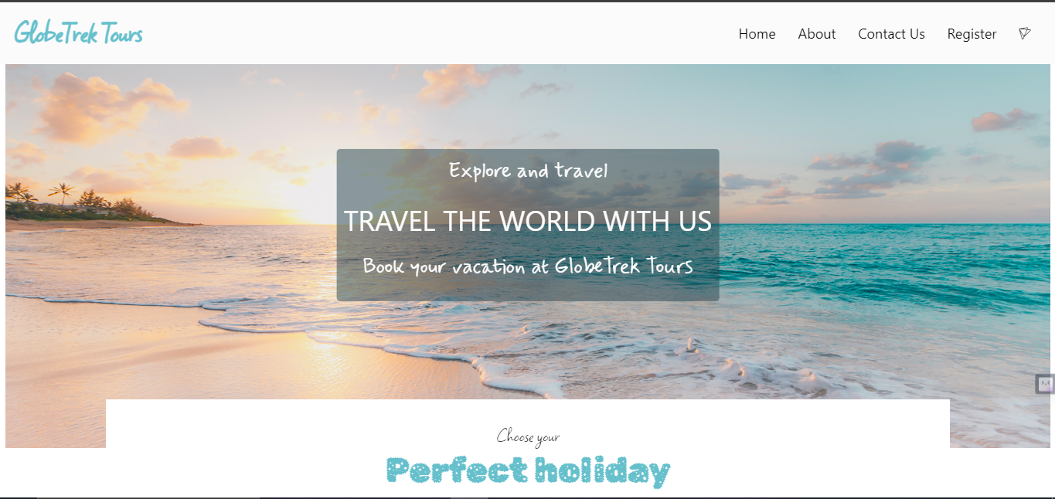
OUTPUT SCREENSHOTS
Frontend
Login and Register
Home Page

Slide 11
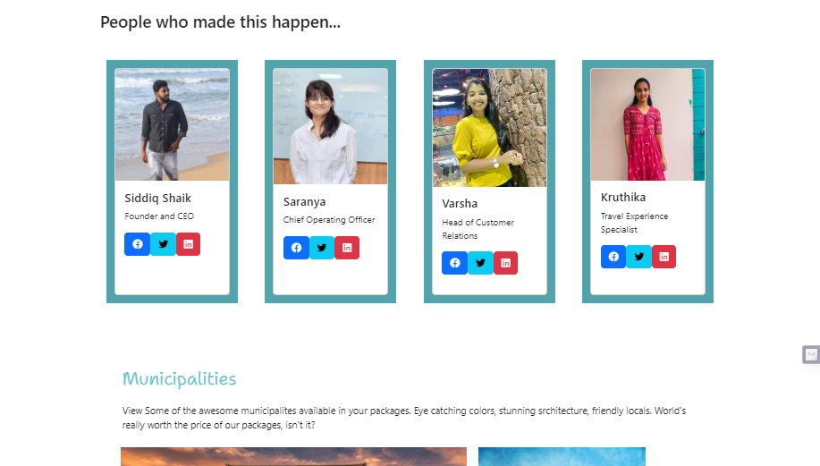
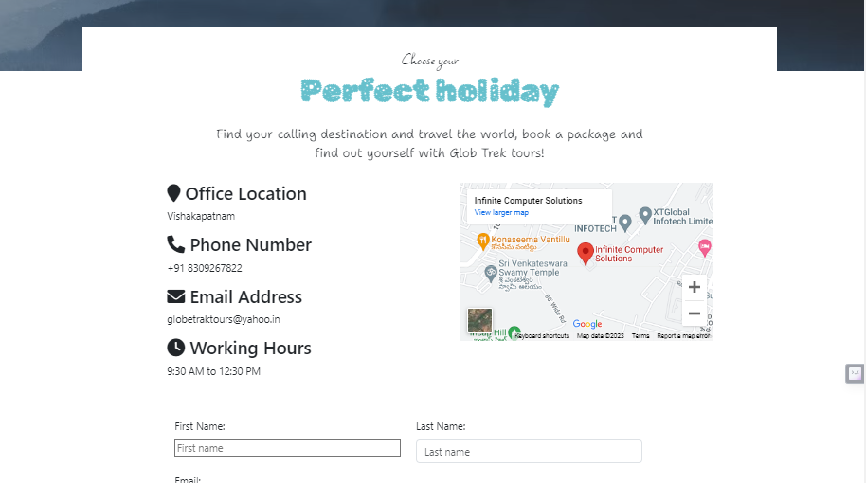
OUTPUT SCREENSHOTS
About Us
Contact Us

Slide 12
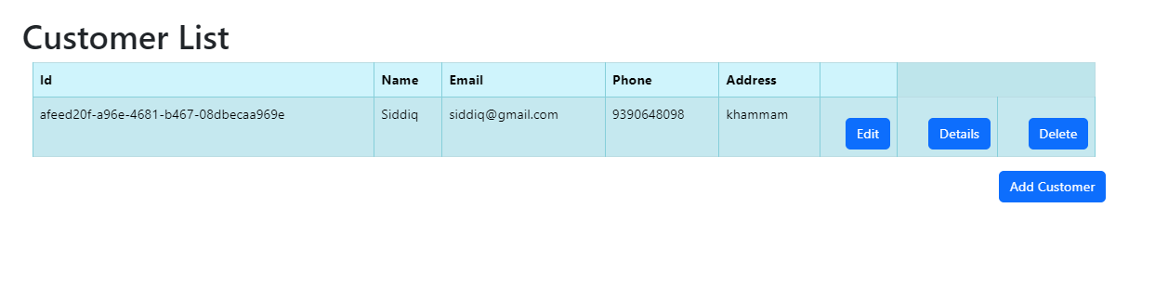
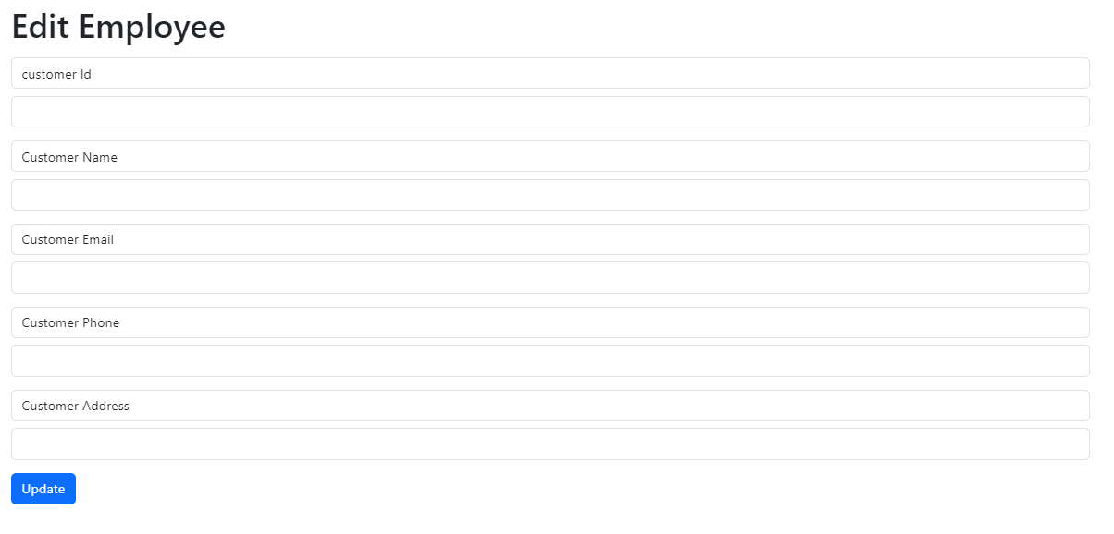
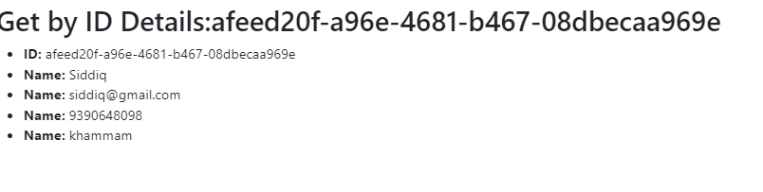
Backend Screenshots

Slide 13
CONCLUSION
This web application provides easy way to book tickets online. This application developed is designed in such a way that any further enhancements can be done with ease.​
Through this website user can book all packages of tourist places and hotels. By using this site we can save our time.​

Slide 14
THANK YOU

